Slide 1

Social Manipulation of NARS
By Donye Wakefield | MS Computer Science

Slide 2
Overview
This project investigates how an AGI inspired system can reason in environments where information comes from multiple sources with different levels of reliability, including truthful, deceptive, and random agents.
This is an experimental project in particular designed to evaluate how the Non-Axiomatic Reasoning System (NARS) specifically performs in an environment where information is socially generated and varies in reliability.
Goal: determine whether NARS can accurately infer true environmental facts while simultaneously learning which information sources are trustworthy, even when some agents provide misleading or inconsistent information.

Slide 3
Experimental Design

Slide 4
Environment Facts
A fixed set of ground-truth facts
Each of these facts represents a simple proposition about the environment
Examples would be “Object A is in location X” or “Condition Y is True”.
Using these propositional statements:
Object A is active
Object B is inactive
Object C is red
Object D is blue
Signal 1 is open
Signal 2 is closed
serves as the referenced standard against which NARS beliefs will be evaluated

Slide 5




Agent Types
Truthful Agents - always provide correct statements that align with the ground-truth fact. High Reliability (≈ 1.0)
Deceptive Agents - always provide incorrect statements that contradict the ground-truth fact. Low Reliability (≈ 0.0)
Noisy Agents - Unintentionally provides statements that either align with ground-truth or contradict the ground-truth (i.e. randomized truth value). Uncertain Reliability (≈ 0.5)
Strategic Agents - Intentionally alternate between truthful and deceptive behavior based on predefined pattern. Variable Reliability (flucuates over time)
Each of these agents acts as an independent information source
Each of these agents correspond to a implicit reliability level. NARS infers these reliability levels over time based on consistency and outcomes of inputted statements

Slide 6
Statement Generation
These agents will continuously produce statements about environment facts.
These statements will be encoded in Narsese then streamed into NARS in a sequence
Each statement includes:
The proposition asserted
Truth value (claimed by the agent)
Source (agent identity)
Allows NARS to reason about the environment and track credibility of the difference sources of information

Slide 7
Metrics
Belief Accuracy - measures how often NARS inferred beliefs track the ground-truth facts; Evaluated over time to determine how quickly the system converges to correct beliefs.
Confidence Evolution - tracks how NARS confidence values for beliefs change as more evidence is accumulated; Evaluates whether there is increase in confidence for correct beliefs and decrease confidence when conflicting evidence appears
Trust Inference - measures ability of NARS to be able to distinguish between reliable and unreliable agents; Evaluates how NARS weights information from different sources over time and sees if it favors truthful agents while discounting deceptive ones.
Misinformation Resistance
This refers to the system’s ability to stay accurate even when some agents provide false or misleading information. A higher score means the system can ignore bad input better and still keep correct beliefs.

Slide 8
Hypothesis
My hypothesis is that NARS should be able to maintain a reasonable belief accuracy even in the presence of deceptive and noisy information.
Additionally, it should demonstrate adaptive trust inference, where reliable agents should be gradually identified and also given more influence in the reasoning process.
I will compare my actual results against this hypothesis

Slide 9
Experiment Results

Slide 10
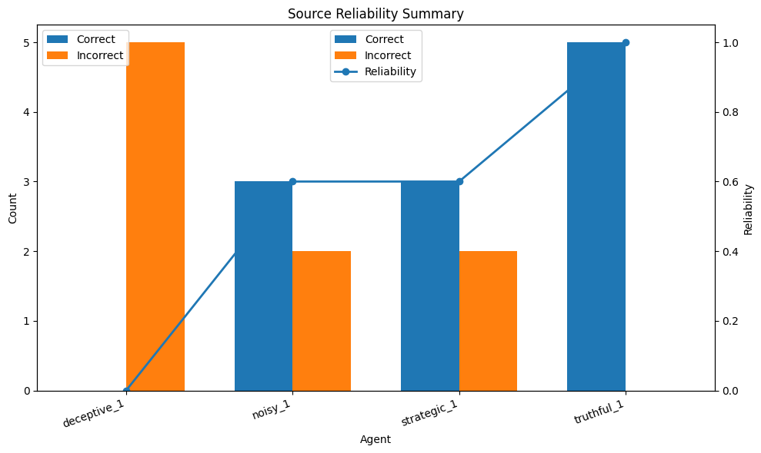
Results
Demonstrates ability to quantify source trustworthiness and Supports evaluation of reasoning under social uncertainty
The system seems to correctly distinguish between agent behaviors
Reliability scores reflect underlying agent strategies
Provides a foundation for trust inference in NARS

Slide 11
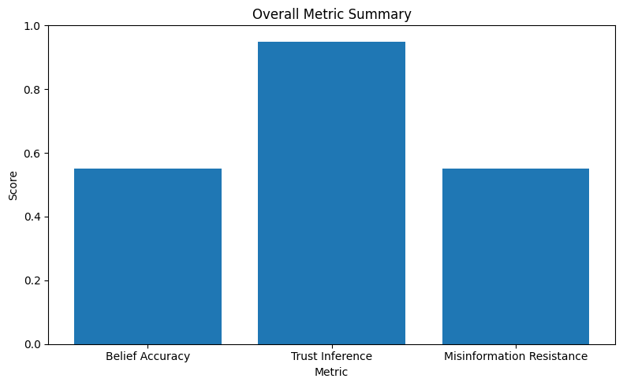
Results
Belief Accuracy
Overall belief accuracy reflects system’s ability to handle mixed information
Performance remains stable despite presence of noise and deception
Trust Inference Capability
System seem to effectively approximates true reliability of agents
Trust inference score indicates how well the system distinguishes agent types
Misinformation Resistance
System maintains a reasonable level of correct beliefs even under misleading input
Shows robustness against adversarial or noisy information

Slide 12
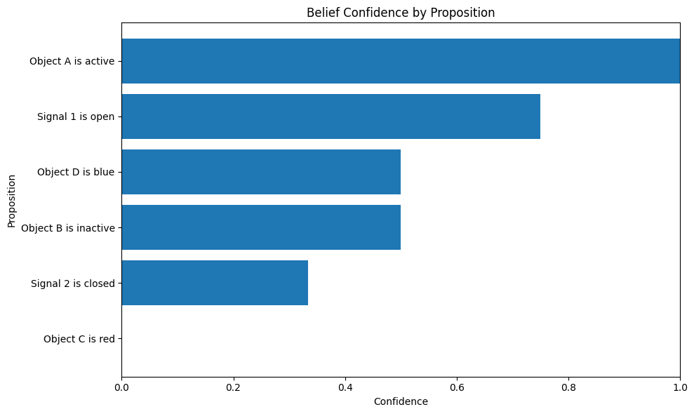
Results
Confidence & Belief Formation
Confidence values seem to align with frequency of supporting vs. contradicting evidence
Demonstrates gradual strengthening or weakening of beliefs over time

Slide 13
The results seem to support the hypothesis as NARS maintained strong belief accuracy despite noisy and deceptive inputs. The system successfully distinguished between reliable and unreliable agents, trust inference improved over time, with more accurate sources having greater influence.
So it seems the system demonstrated robustness in reasoning under social uncertainty but only off of a few statements.
Conclusion

Slide 14
Future tasks
Run more experiment conditions, especially baseline, mixed, and adversarial cases:
Baseline: all agents truthful (ideal case)
Mixed: combination of truthful, noisy, and deceptive agents
Adversarial: majority deceptive agents to stress-test the system
Track metrics over time, not just final totals; Identify how quickly the system adapts to correct or incorrect information
Compare how different agent types affect belief confidence and trust learning; Helps determine which agents cause the most confusion or error
Expand the experiment into a fuller test of NARS reasoning under uncertainty
* Note that this project was a first attempt and the results shown today may likely change in my final implemented system

